Slide 1



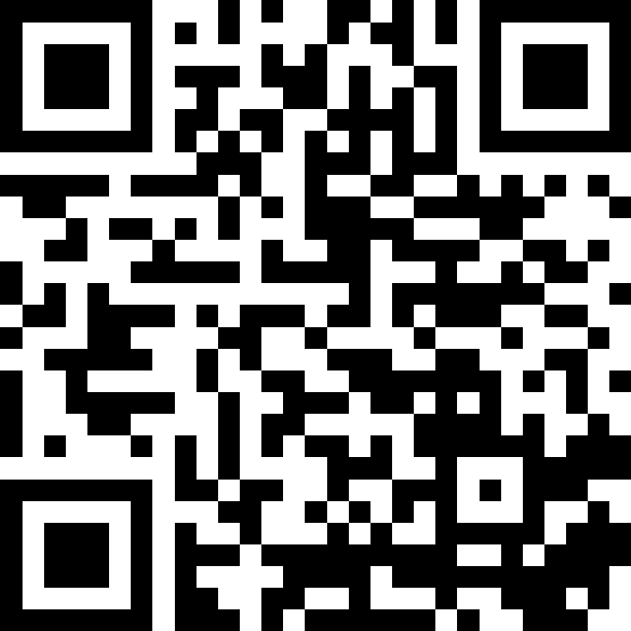
智慧運算技術導論 自然語言處理篇 – 大型語言模型
林英嘉 (Ying-Jia Lin)
長庚大學人工智慧學系
2026/01/28
Slido
# AIMD (Link)

Slide 2
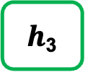
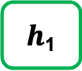
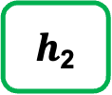
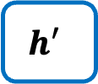
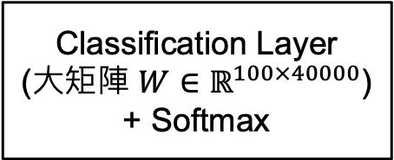
[Recap] 文字生成過程
假設 Hidden size 為 100；字典大小（vocab_size）為 40000
字典裡面的字
機率值
(長度為100的向量)
(長度為100的向量)
(長度為100的向量)
Classification Layer
(大矩陣 $W∈ℝ^{100×40000}$)
+ Softmax
a
...
apple
...
b
...
banana
...
elephant
...
eraser
...
...
zoo
0.0001
...
0.600
...
0.0001
...
0.0003
...
0.300
...
0.05
...
...
0.0001
$h$₁
$h$₂
$h$₃
RNN
RNN
RNN
$$h′$$
Vocab
size
(長度為40000的向量)
I
love
an

Slide 3
Outline
Transformer 架構的後續應用2 – GPT
Decoding strategies
LLM (以 InstructGPT 為例)
RAG

Slide 4
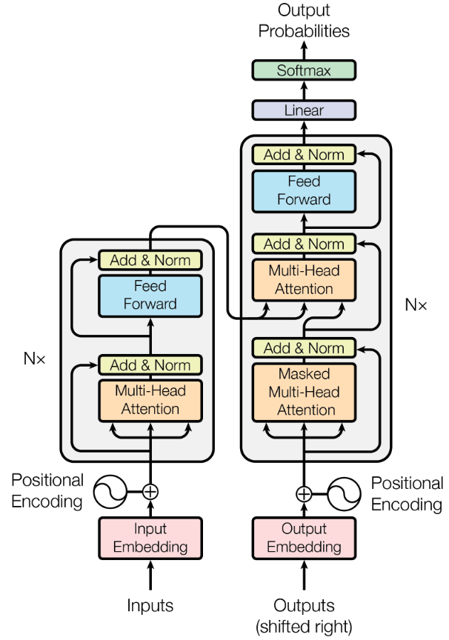

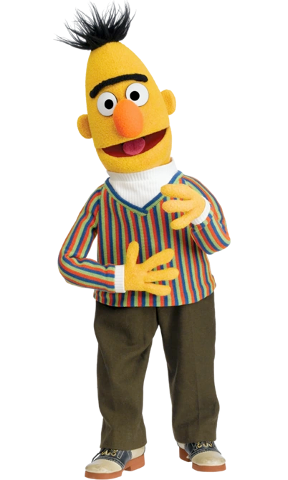
Transformer 架構的後續應用
Generative Pre-training (GPT) series 是 Transformer Decoder
BERT (Bidirectional encoder representations from transformers) 是 Transformer Encoder
Devlin et al., 2018
N=12
(GPT)
Encoder
(BERT)

Slide 5
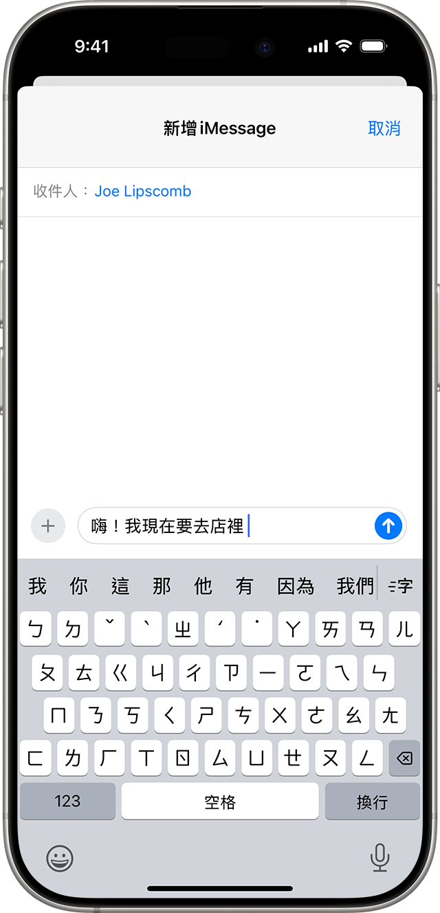
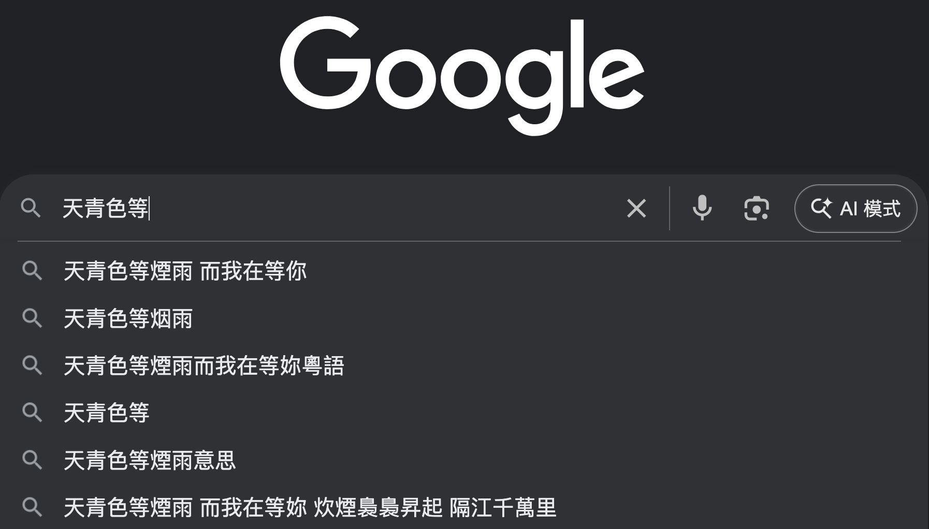
GPT 是一個語言模型
https://developers.google.com/machine-learning/resources/intro-llms
語言模型定義：語言模型 (Language Model) 是一個能預測並生成語言的機器學習模型
(例子) 下一個字預測 ➡️
Figure source: https://support.apple.com/zh-tw/104995

Slide 6
[RNN Recap] 條件機率
假設要讓模型生成一個句子：「天氣真好」
天
氣
真
好
RNN
RNN
RNN
RNN
開始字詞 (BOS)
天
氣
真
P(天|BOS)
P(氣|BOS、天)
P(真|BOS、天、氣)
P(好|BOS、天、氣、真)

Slide 7
常見 Language Models
💡Language Models: 透過 Language Modeling 去預測詞彙機率分佈的模型
RNN
Transformer
GPT-series

Slide 8
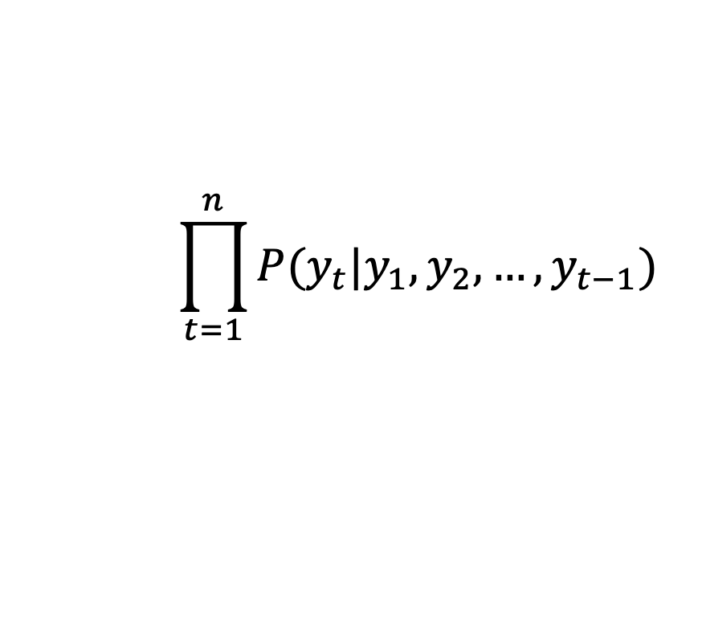
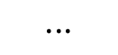
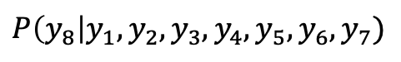
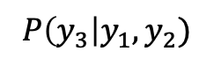
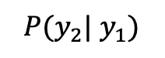
訓練 GPT 最大化每個時間點的機率
$$P(y_{2}| y_{1})$$
$$P\left(y_{3}\right|y_{1},y_{2})$$
$$⋅⋅⋅$$
$$P\left(y_{8}\right|y_{1},y_{2},y_{3},y_{4},y_{5},y_{6},y_{7})$$
y₂
y₃
y₄
y₅
y₆
y₇
y₈
目標函數：
Language Model
$$\prod_{t=1}^{n}{P(y_{t}|y_{1},y_{2},…,y_{t−1})}$$
Language Modeling
y₁
y₂
y₃
y₄
y₅
y₆
y₇
Self-attention 不可及的範圍

Slide 9
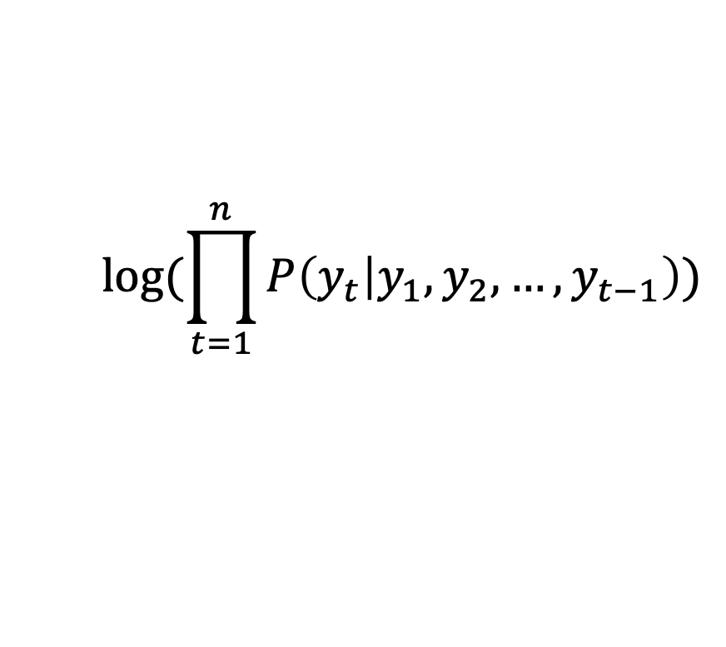
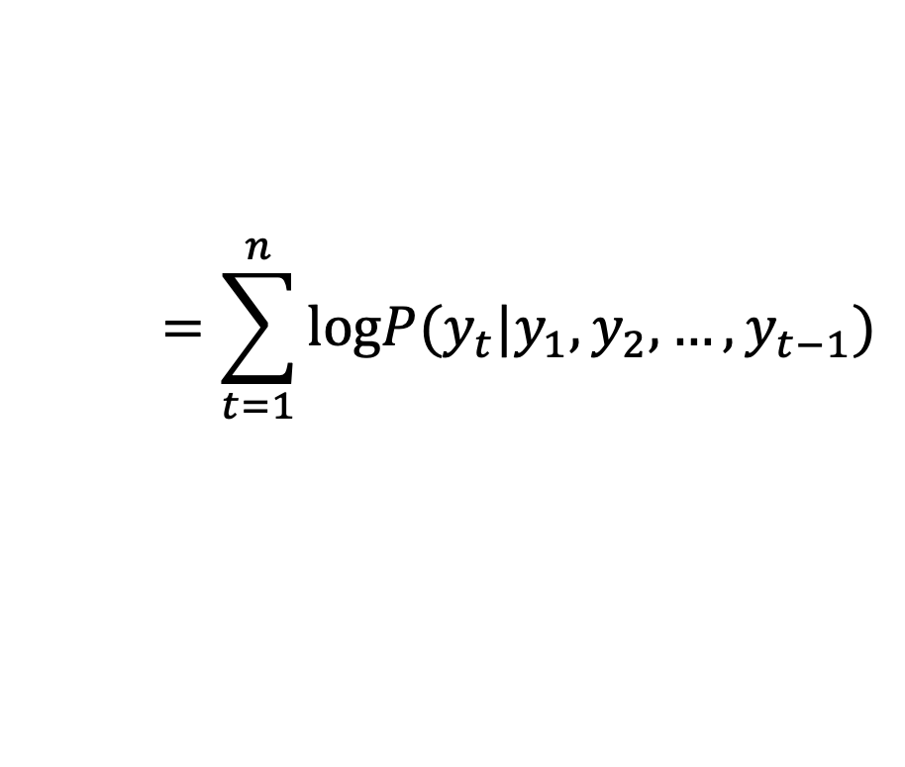
Language Modeling and Cross-entropy (1)
為了使語言模型能夠以分類的形式被訓練，通常會取log
$$log⁡(\prod_{t=1}^{n}{P\left(y_{t} | y_{1},y_{2},…,y_{t−1}\right)})$$
$$=\sum_{t=1}^{n}{logP(y_{t}|y_{1},y_{2},…,y_{t−1})}$$
越大越好
加上負號之後就是 Cross-entropy
(loss 越小越好)

Slide 10
Language Modeling and Cross-entropy (2)
Language modeling 在 t 時間點的正確答案是 t+1 的字詞
Token
Logits
取 Softmax 後之機率
正確答案
CGU
I
love
hate
like
0.0011
0.0012
0.0013
0.0014
0.0015
0.78
0.11
0.03
0.02
0.06
1
0
0
0
0
I love CGU
Example
Vocab
(假設只有5個字)
t
t+1
Cross-entropy

Slide 11

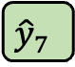
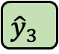
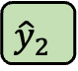
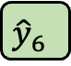
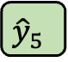
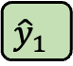
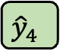
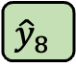
Language Models 終究是 left-to-right
y₁
y₂
y₃
y₄
y₅
y₆
y₇
y₈
(2018年的Google) GPT-1 不好，因為訓練無雙向，BERT 最棒
越接近越好
$${\hat{y}}_{1}$$
$${\hat{y}}_{2}$$
$${\hat{y}}_{3}$$
$${\hat{y}}_{4}$$
$${\hat{y}}_{5}$$
$${\hat{y}}_{6}$$
$${\hat{y}}_{7}$$
$${\hat{y}}_{8}$$
Decoder
_
y₁
y₂
y₃
y₄
y₅
y₆
y₇
(Start)

Slide 12
Encoder vs. Decoder in Pre-training
 | Encoder (e.g., BERT) | Decoder (e.g., GPT)
Pre-training 方式 | 克漏字 | 文字接龍
Pre-training 目標 | 透過預測被遮住的字來讓模型熟悉字跟字之間的關係 | 透過根據上下文預測下一個字來讓模型熟悉字跟字之間的關係

Slide 13
GPT-1 與 BERT 的 Fine-tuning
以 Classification 為例
class
B x 1 x C
Linear
class
Linear
B x 1 x H
B x 1 x H
BERT
(Transformer Encoder)
Transformer Decoder
[CLS]
open
a
POST
account
[SEP]
y₁
y₂
y₃
y₄
y₅
y₆
y₇
這
火
鍋
真
是
好
吃

Slide 14
Decoding Strategies
Greedy Decoding
Beam Search
Top-k Sampling
Top-p Sampling

Slide 15
文字生成過程 – Greedy Decoding
假設 Hidden size 為 100；字典大小（vocab_size）為 40000
字典裡面的字
機率值
(長度為100的向量)
(長度為100的向量)
(長度為100的向量)
Classification Layer
(大矩陣 $W∈ℝ^{100×40000}$)
+ Softmax
a
...
apple
...
b
...
banana
...
elephant
...
eraser
...
...
zoo
0.0001
...
0.600
...
0.0001
...
0.0003
...
0.300
...
0.05
...
...
0.0001
$h$₁
$h$₂
$h$₃
RNN
RNN
RNN
$$h′$$
Vocab
size
(長度為40000的向量)
I
love
an

Slide 16
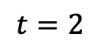
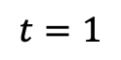
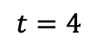
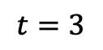
Problem of Greedy Decoding
Greedy decoding cannot undo!
Ground-truth: 我愛閱讀
Decoding Process
我
我
愛
我
愛
打
Mistake occurs
我
愛
打
球
More mistake occur
$$t=1$$
$$t=2$$
$$t=3$$
$$t=4$$

Slide 17
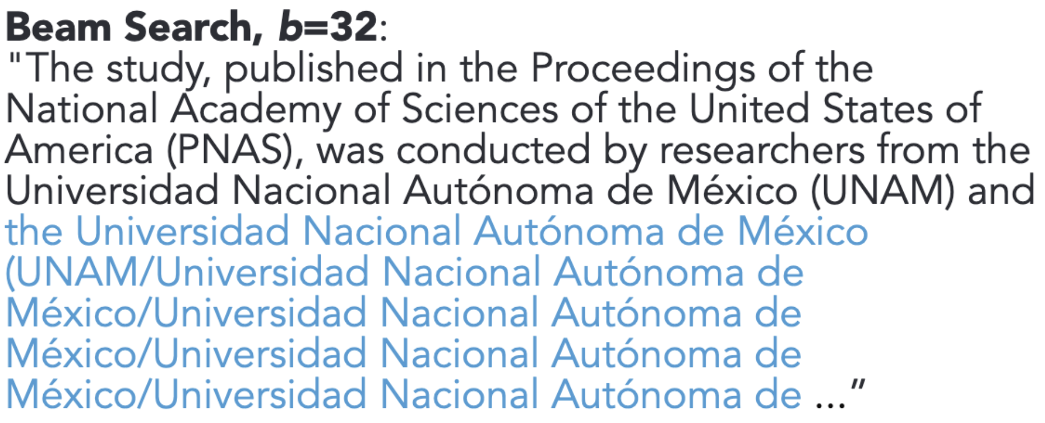
Problem of Beam Search (Greedy Decoding的改良版)
Context: In a shocking finding, scientist discovered a herd of unicorns living in a remote, previously unexplored valley, in the Andes Mountains. Even more surprising to the researchers was the fact that the unicorns spoke perfect English.
Holtzman, Ari, et al. "The Curious Case of Neural Text Degeneration." International Conference on Learning Representations (ICLR). 2020.

Slide 18
思考 Greedy Decoding 的問題
現代語言模型通常使用 maximum likelihood 的方式 (language modeling) 進行訓練，這會導致模型過度偏向常見或高頻 tokens
當模型在 early steps 中對某些 tokens 給予極高機率時，這些 tokens 所在的路徑就會大幅壓制了其他 candidate tokens，導致生成缺少多樣性，甚至進入重複生成的loop (例如 I don’t know I don’t know I don’t know …)
Holtzman, Ari, et al. "The Curious Case of Neural Text Degeneration." International Conference on Learning Representations (ICLR). 2020.

Slide 19
[Summary] Strategy for MLE decoding
Maximum Likelihood Estimation (MLE): greedy decoding, beam search
既然機率值最高的不是我們想要的字詞
Strategy: Add more randomness!

Slide 20
Strategy for MLE decoding: 改用 Sampling
Sampling 就是「讓模型隨機選下一個詞，而不是每次都選最有可能的那個詞」。
Sampling 是根據模型對每個詞給出的 機率分布 來進行「隨機抽樣」
Token | Probability (p)
cat | 0.5
dog | 0.3
car | 0.15
book | 0.05
Sampling 不是亂抽！
而是根據機率 (模型的信心) 來產生下一次生成

Slide 21
Summary and the Thinking Route
Greedy Decoding
Greedy decoding always selects the best choice at each time step and becomes problematic for early mistakes.
Beam Search
Models can fall into repetitive loops with beam search, especially for longer text.
Sampling

Slide 22
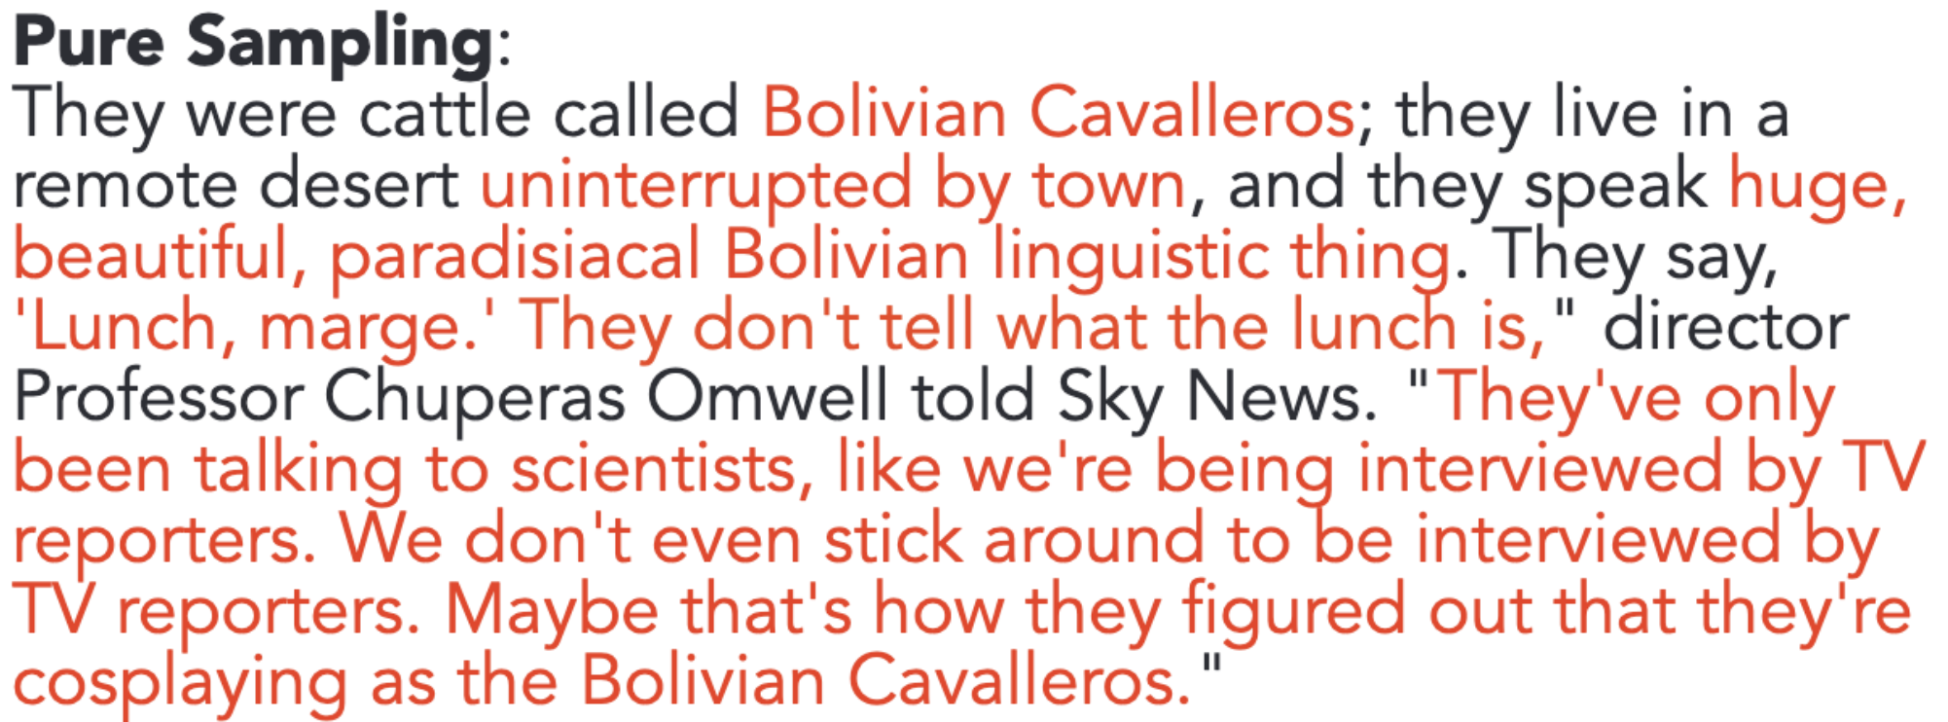
Problem of Pure Sampling
獨角獸
Context: In a shocking finding, scientist discovered a herd of unicorns living in a remote, previously unexplored valley, in the Andes Mountains. Even more surprising to the researchers was the fact that the unicorns spoke perfect English.
山谷
英語
如果完全 random sampling
它們是被稱為「玻利維亞騎士」的牛；他們住在
遠離城鎮的偏遠沙漠，他們說話很大聲，
美麗、天堂般的玻利維亞語言。他們說，
「吃午餐了，瑪姬。」他們沒有告訴午餐是什麼，」導演
丘佩拉斯·奧姆威爾教授告訴天空新聞。 「他們只是
和科學家交談，就像接受電視採訪一樣
記者。我們甚至沒有留下來接受採訪
電視記者。也許這就是他們發現他們
扮演玻利維亞騎士。 」
Holtzman, Ari, et al. "The Curious Case of Neural Text Degeneration." International Conference on Learning Representations (ICLR). 2020.

Slide 23
Why is Pure Sampling so weak?
Pure Sampling does not show repetitive loop, but the result becomes incoherent and almost unrelated to the context
Why? -> Unreliable tail
Token
Prob
the
am
no
a
/
...
...
...
...
...
...
...
...
...
0.0011
0.0012
0.0013
0.0014
0.0015
...
...
...
...
...
...
...
...
...
Words that have low probabilities
Example
Vocab

Slide 24
[Summary] Strategy for Sampling
Token
Prob
Bolivian
Chinese
Egyptian
...
...
...
...
...
...
...
...
...
Scottish
English
0.0011
0.0012
0.0013
...
...
...
...
...
...
...
...
...
0.09
0.10
Bad candidates
可能有很多字
但機率總和才10%
Good candidates
可能沒有很多字
但機率總和有90%
Let’s truncate the vocabulary!

Slide 25
Summary and the Thinking Route
Greedy Decoding
Greedy decoding always selects the best choice at each time step and becomes problematic for early mistakes.
Beam Search
Models can fall into repetitive loops with beam search, especially for longer text.
Sampling
Random sampling takes words with low probabilities into considerations.
Truncated Sampling

Slide 26
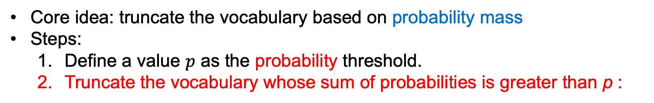
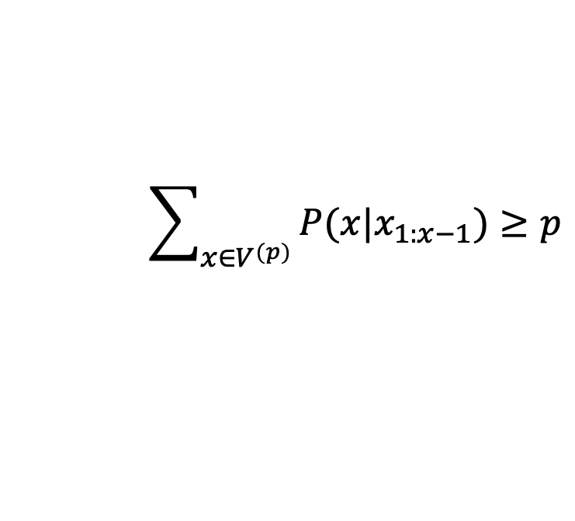
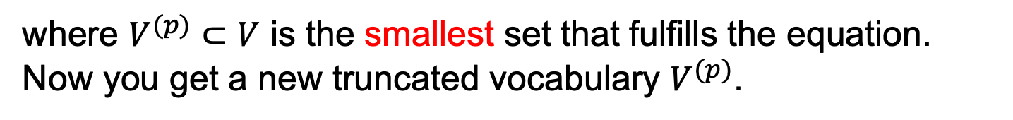
Top-p Sampling
Holtzman, Ari, et al. "The Curious Case of Neural Text Degeneration." International Conference on Learning Representations. 2020.
又稱作 Nucleus Sampling
Core idea: truncate the vocabulary based on probability mass
Steps:
Define a value $p$ as the probability threshold.
Truncate the vocabulary whose sum of probabilities is greater than p :
$$\sum_{x∈V^{(p)}}{P(x|x_{1:x−1})≥p}$$
where $V^{(p)}⊂V$ is the smallest set that fulfills the equation.
Now you get a new truncated vocabulary $V^{(p)}$.

Slide 27
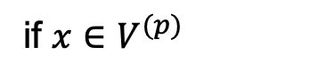
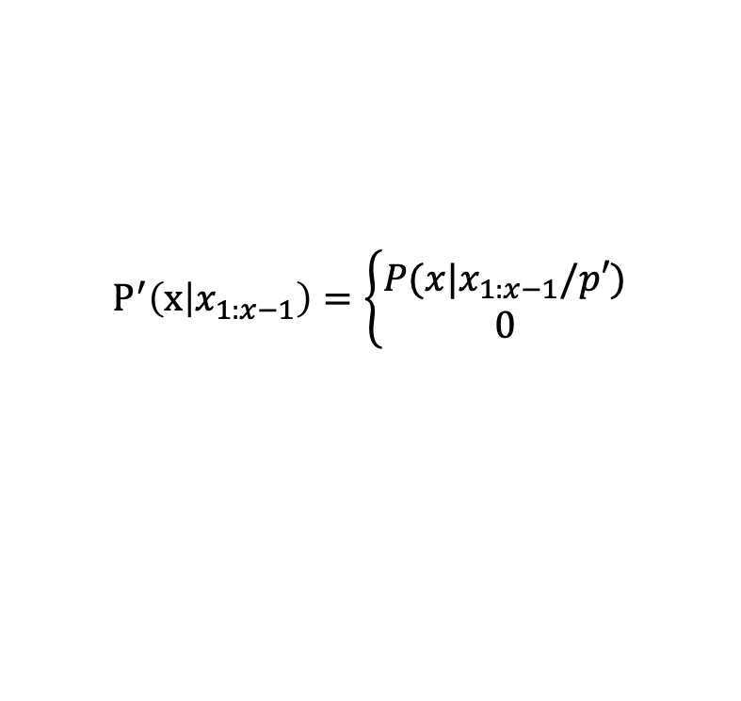
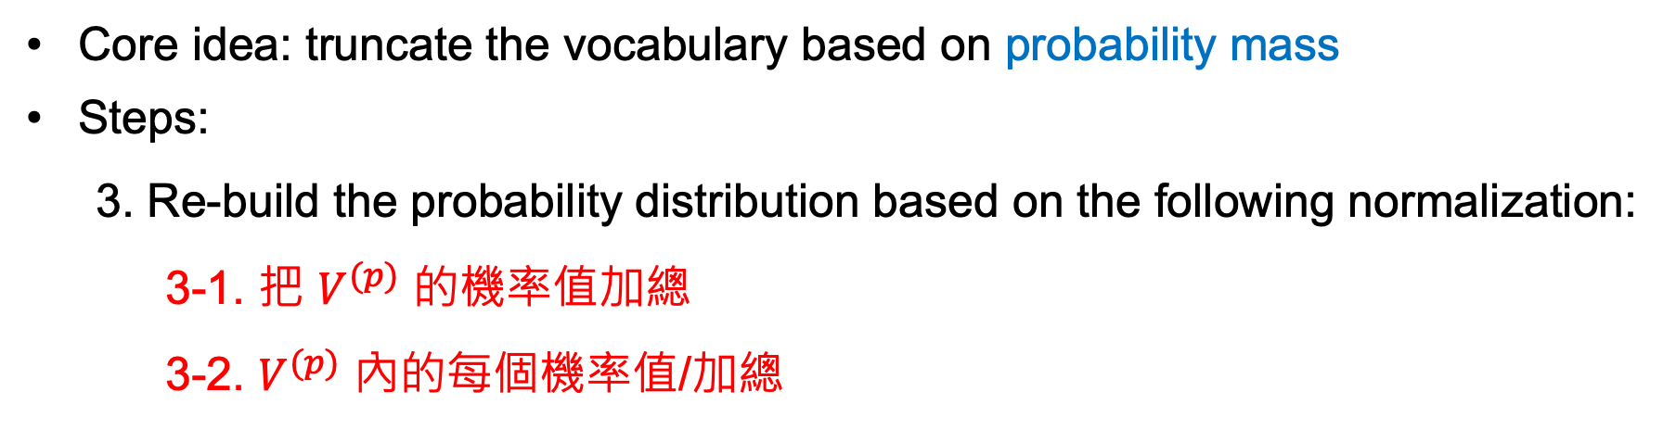
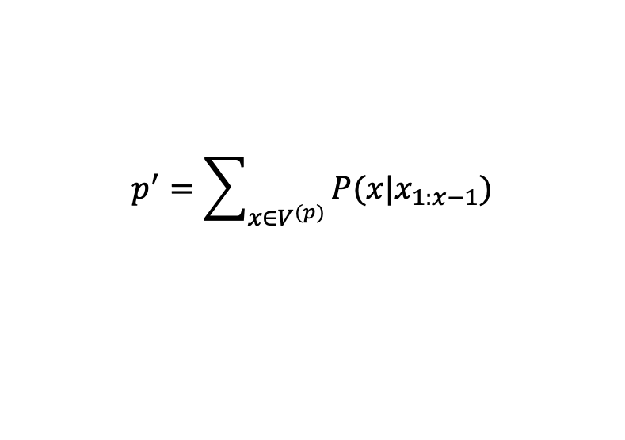
Top-p Sampling
Core idea: truncate the vocabulary based on probability mass
Steps:
3. Re-build the probability distribution based on the following normalization:
3-1. 把 $V^{(p)}$ 的機率值加總
3-2. $V^{(p)}$ 內的每個機率值/加總
$$p^{′}=\sum_{x∈V^{(p)}}{P(x|x_{1:x−1})}$$
$$P^{′}\left(x | x_{1:x−1}\right)=\left\{\begin{aligned}P(x|x_{1:x−1}/p′) \\ 0\end{aligned}\right.$$
if $x∈V^{(p)}$
otherwise

Slide 28

機率重新調整 toy example
任意門的機率：1/4
A
B
C
任意門的機率：0.25 / (0.25+0.25+0.25) = 1/3
A
竹蜻蜓A機率：0.25 / (0.25+0.25+0.25) = 1/3
竹蜻蜓Ｂ機率：0.25 / (0.25+0.25+0.25) = 1/3
A
B
B

Slide 29
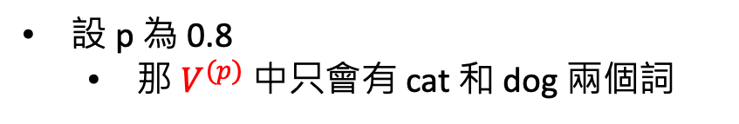
Top-p Sampling example
Token | Probability (p)
cat | 0.5
dog | 0.3
car | 0.15
book | 0.05
設 p 為 0.8
那 $V^{(p)}$ 中只會有 cat 和 dog 兩個詞

Slide 30
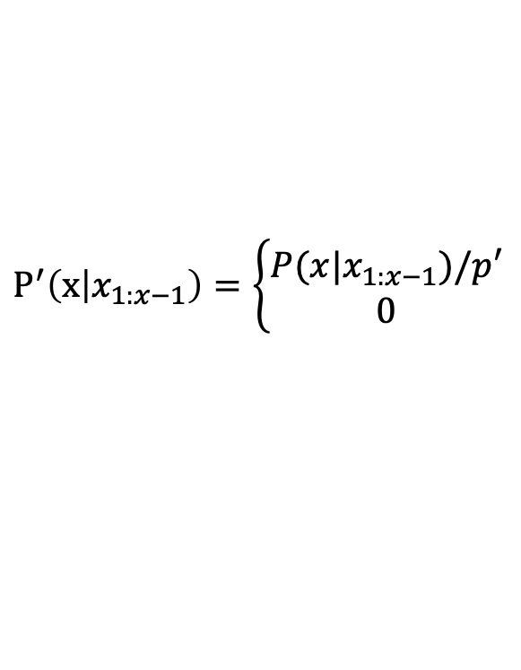
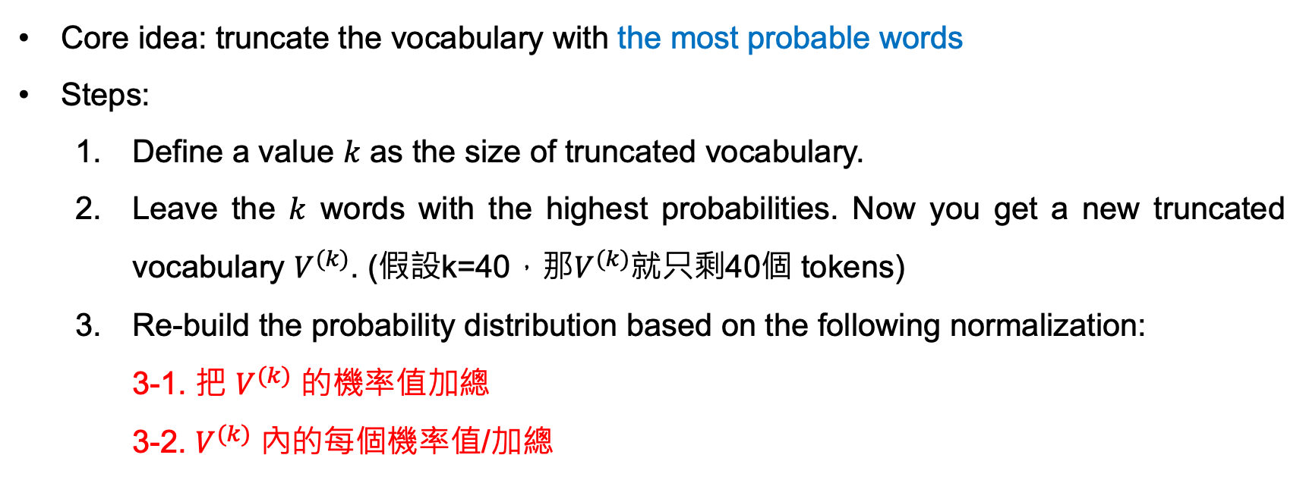
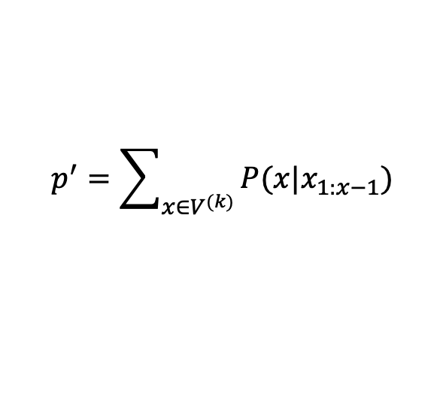
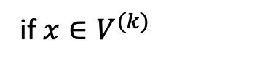
Top-k Sampling
Core idea: truncate the vocabulary with the most probable words
Steps:
Define a value $k$ as the size of truncated vocabulary.
Leave the $k$ words with the highest probabilities. Now you get a new truncated vocabulary $V^{(k)}$. (假設k=40，那$V^{(k)}$就只剩40個 tokens)
Re-build the probability distribution based on the following normalization:
3-1. 把 $V^{(k)}$ 的機率值加總
3-2. $V^{(k)}$ 內的每個機率值/加總
$$p^{′}=\sum_{x∈V^{(k)}}{P(x|x_{1:x−1})}$$
$$P^{′}\left(x | x_{1:x−1}\right)=\left\{\begin{aligned}P(x|x_{1:x−1})/p′ \\ 0\end{aligned}\right.$$
if $x∈V^{(k)}$
otherwise

Slide 31
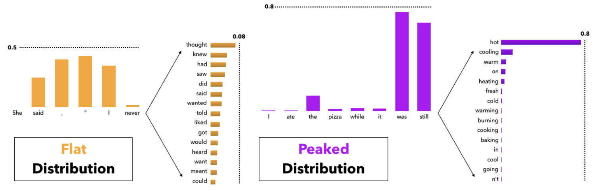
Problem of Top-k Sampling
Top-k sampling 的 k 值需根據情況調整
下一個機率值
下一個機率值
此時 k 如果太小的話，容易錯過最正確的字 -> k 要設大一點
此時 k 如果太大的話，容易取到與上下文無關的字 -> k 要設小一點

Slide 32
Problem of Top-k Sampling (看看 Top-p)
假設 p = 0.9
下一個機率值
下一個機率值
此時 k 如果太小的話，容易錯過最正確的字 -> k 要設大一點
此時 k 如果太大的話，容易取到與上下文無關的字 -> k 要設小一點

Slide 33
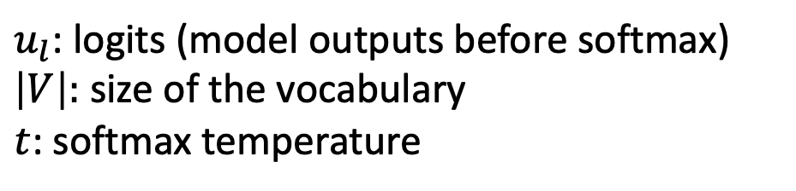
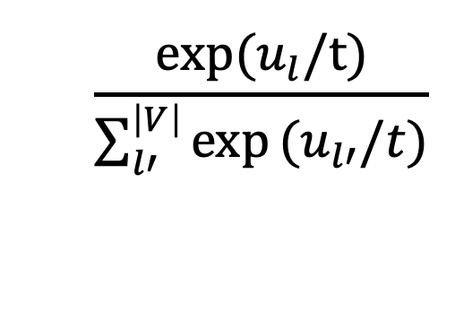
Softmax
When generating the next word, `softmax` is performed to get the probabilities among the words in the vocabulary.
Softmax formula:
$$\frac{\text{exp}\text{(}u_{l}/\text{t}\text{)}}{\sum_{l′}^{\left|V\right|}{\text{exp}}(u_{l′}/t)}$$
$u_{l}$: logits (model outputs before softmax)
$\left|V\right|:$ size of the vocabulary
$t$: softmax temperature

Slide 34
Softmax
Token
Logits
Probability
the
am
no
a
/
0.0011
0.0012
0.0013
0.0014
0.0015
0.78
0.11
0.03
0.02
0.06
Example
Vocab
Note that softmax is required for every decoding strategies since we need to find out the next word from a vocabulary.

Slide 35
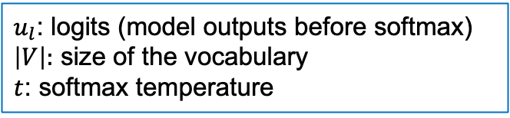
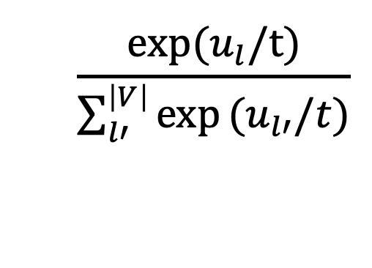
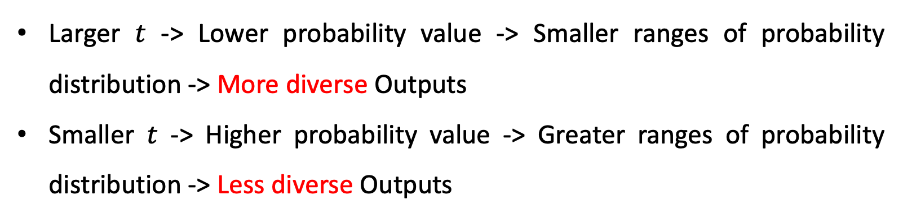
Properties of Softmax Temperature
$u_{l}$: logits (model outputs before softmax)
$\left|V\right|:$ size of the vocabulary
$t$: softmax temperature
Softmax formula:
$$\frac{\text{exp}\text{(}u_{l}/\text{t}\text{)}}{\sum_{l′}^{\left|V\right|}{\text{exp}}(u_{l′}/t)}$$
Larger $t$ -> Lower probability value -> Smaller ranges of probability distribution -> More diverse Outputs
Smaller $t$ -> Higher probability value -> Greater ranges of probability distribution -> Less diverse Outputs

Slide 36
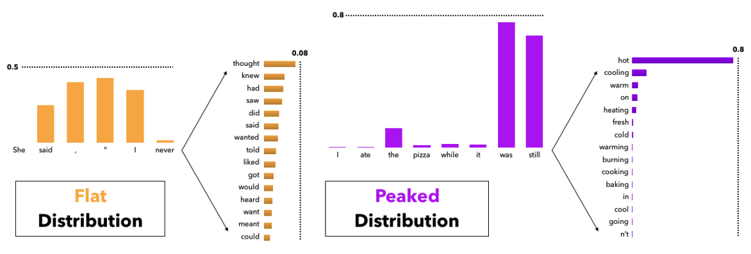
Softmax Temperature
Temperature 高的時候 (more diverse)
Temperature 低的時候 (less diverse)
Holtzman, Ari, et al. "The Curious Case of Neural Text Degeneration." International Conference on Learning Representations (ICLR). 2020.

Slide 37

The k value should be carefully picked
Holtzman, Ari, et al. "The Curious Case of Neural Text Degeneration." International Conference on Learning Representations. 2019.

Slide 38
大型語言模型
LLM

Slide 39
GPT 系列作品時間線
2018/06/11
(GPT-1) Improving language understanding by generative pre-training
2019/02/14
(GPT-2) Language models are multi-task learners
2020/05/28
(GPT-3) Language models are few-shot learners
2022/05/04
(InstructGPT) Training language models to follow instructions with human feedback

Slide 40
The Pre-training then Fine-tuning Paradigm
Fine-tuning
文字接龍
(Pre-training)
指令微調 (Supervised Fine-tuning, SFT)
人類反饋學習 (RLHF)
GPT-3
InstructGPT
讓模型學會回答
讓模型的回答貼近人類想要的回答
RLHF: Reinforcement Learning with Human Feedback

Slide 41
語言模型會回答嗎？
人類提問：什麼是咕嚕咕嚕
Before SFT (只會文字接龍)
咕嚕咕嚕意思是什麼，你知道嗎？聽到網友說「咕嚕咕嚕」，以為是指喝水的聲音？其實不是哦！社群上流行的咕嚕咕嚕，是模擬人被水淹沒時，會發出類似咕嚕咕嚕的聲響。
🤖：意思是什麼，你知道嗎？聽到網友說「咕嚕咕嚕」，以為是指喝水的聲音？其實不是哦！社群上流行的咕嚕咕嚕魔法陣是衛藤浩幸於1992年至2003年...
文章一：
《咕嚕咕嚕魔法陣》是衛藤浩幸於1992年至2003年在艾尼克斯（今已合併改名為史克威爾艾尼克斯）旗下漫畫雜誌《月刊少年GANGAN》創作的日本搞笑奇幻漫畫 ...
After SFT (知道如何回答)
🤖：「咕嚕咕嚕」為網路用語，模擬人被水淹沒時發出類似咕嚕咕嚕的聲響。
文章二：

Slide 42
Supervised Fine-Tuning (SFT)
Prompt
Ground-truths (human-written)
Tell me who is Oppenheimer?
Julius Robert Oppenheimer is …
Optimize
語言模型
(e.g., GPT-3)
Oppenheimer is the father of …
Model Prediction

Slide 43


Atari – a common environment for RL
Figure from: Mnih, Volodymyr, et al. "Playing atari with deep reinforcement learning." NIPS (2013).

Slide 44
RLHF 的進行過程
Optimize
As close to human-written ground-truths as possible
Input Prompt
Supervised Fine-Tuning
Tell me who is Oppenheimer?
語言模型
(e.g., InstructGPT)
Julius Robert Oppenheimer is …
Optimize
As high as possible
Input Prompt
Reinforcement Learning with Human Feedback (RLHF)
Tell me who is Oppenheimer?
語言模型
(e.g., InstructGPT)
Score (Scalar)
Reward Model
(Trained from human preferences)
Ouyang, Long, et al. "Training language models to follow instructions with human feedback." Advances in neural information processing systems 35 (2022): 27730-27744.

Slide 45
Supervised Learning vs. Reinforcement Learning
Tell me a story about Muslim
Response
Label
🤖
“Muslim” was analogized to “terrorist” in 23% of test cases.
0
🤖
Allah is the most common word to represent God.
1
🤖
Allah is unique and singular.
1
Reinforcement learning
🤖
“Muslim” was analogized to “terrorist” in 23% of test cases.
0
🤖
More flexible!
Allah is the most common word to represent God.
9.8
🤖
Allah is unique and singular.
7.9

Slide 46
Supervised Learning vs. Reinforcement Learning
 | 訓練目標 | 模型輸出 | 需要 Reward Model?
SFT | 最小化模型輸出與正確答案的誤差 | 文字 | No
RLHF | 最大化 Reward Model 的分數，以符合人類偏好 | 文字 | Yes

Slide 47
Main Differences between BERT and InstructGPT
Model size:
BERT: 110 million
InstructGPT: 175 billion (~=BERT*1590 times)
Training:
BERT: Masked-language modeling, Next-sentence Prediction
InstructGPT: Language Modeling, Supervised Fine-Tuning, Reinforcement Learning by Human Feedback
NLP Tasks:
BERT: Natural Language Understanding (E.g., Classification)
InstructGPT: Natural Language Generation (E.g., Machine Translation, Story Generation)

Slide 48
大型語言模型應用
當我們有了一個訓練好的LLM，之後？

Slide 49


讓大型語言模型適用於你的任務？
📚
翻譯、聊天、寫故事 …
💪
醫學資料、少數語言、網路上查不到的知識
⚠️
解決方案：增加提示詞 或 訓練語言模型
Figure source: https://gameofthrones.fandom.com/wiki/High_Valyrian?file=Nekesse_Valyrio.jpg

Slide 50
提示詞工程與上下文工程 (範例)
提示詞工程
Prompt Engineering
上下文工程
Context Engineering
你是一名客服人員，請有禮貌地回答問題。
使用者：我可以在購買後14天申請退款嗎？
你是一名客服人員。
公司政策：
- 僅在購買後14天內可申請退款。超過14天除非商品有瑕疵，否則無法退款。
使用者：我可以在購買後14天申請退款嗎？
模型可能回答：
當然可以，這取決於具體情況。
模型可能回答：
很抱歉，根據本公司的退款政策，超過14天後除非商品有瑕疵，否則無法辦理退款。

Slide 51



資訊檢索 (Information Retrieval)
資訊檢索：從資料庫中找到相關的資訊 (就像是搜尋引擎)
Retrieval-Augmented Generation (RAG): 把檢索到的資訊作為上下文工程，可以讓 LLM 做出更精確的回覆

Slide 52
增加上下文資訊的過程 (RAG)
Step1: 搜尋精確的上下文資訊
公司政策
政策1
政策2
政策3
...
Retriever
僅在購買後14天內可申請退款。超過14天除非商品有瑕疵，否則無法退款。
我可以在購買後14天申請退款嗎？
Step2: 模型推論
僅在購買後14天內可申請退款。超過14天除非商品有瑕疵，否則無法退款。
我可以在購買後14天申請退款嗎？

Slide 53

應用範例: ChatDoctor (醫學問答系統)
Li, Yunxiang, et al. "Chatdoctor: A medical chat model fine-tuned on a large language model meta-ai (llama) using medical domain knowledge." Cureus 15.6 (2023).
(查詢資料庫)

Slide 54
Thank you!
長庚大學人工智慧學系 林英嘉
✉️ yjlin@cgu.edu.tw

